Slide 1
Snake game

Slide 2
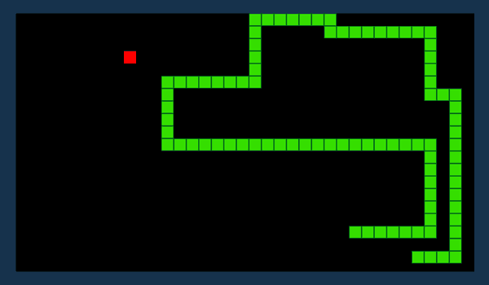
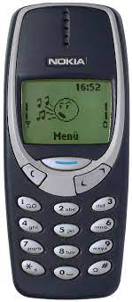
Snake game
Snake is the common name for a video game concept where the player maneuvers a line which grows in length, with the line itself being a primary obstacle. After a variant was preloaded on Nokia mobile phones in 1998, there was a resurgence of interest in the snake concept as it found a larger audience

Slide 3
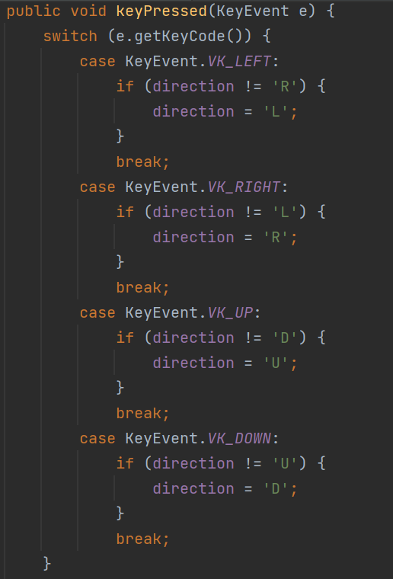
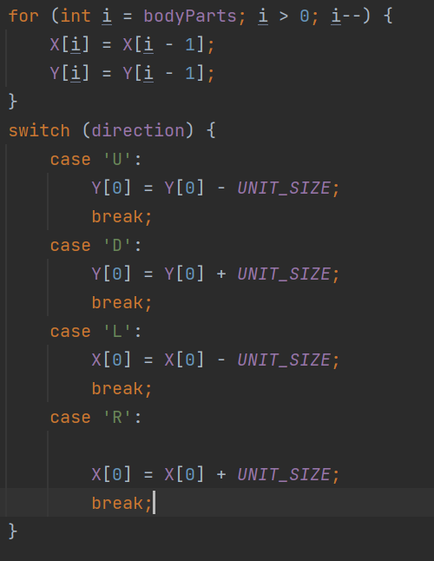
Motion, direction and keys
This code of directions: UP, DOWN, LEFT, RIGHT. This code is used to code arrow code.
This is code of arrows. By arrow you can control snake.

Slide 4
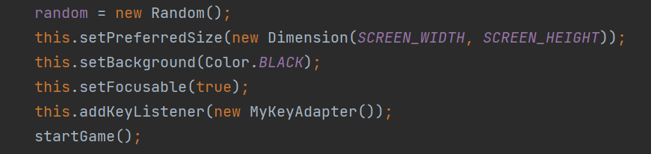
Panel code

Slide 5
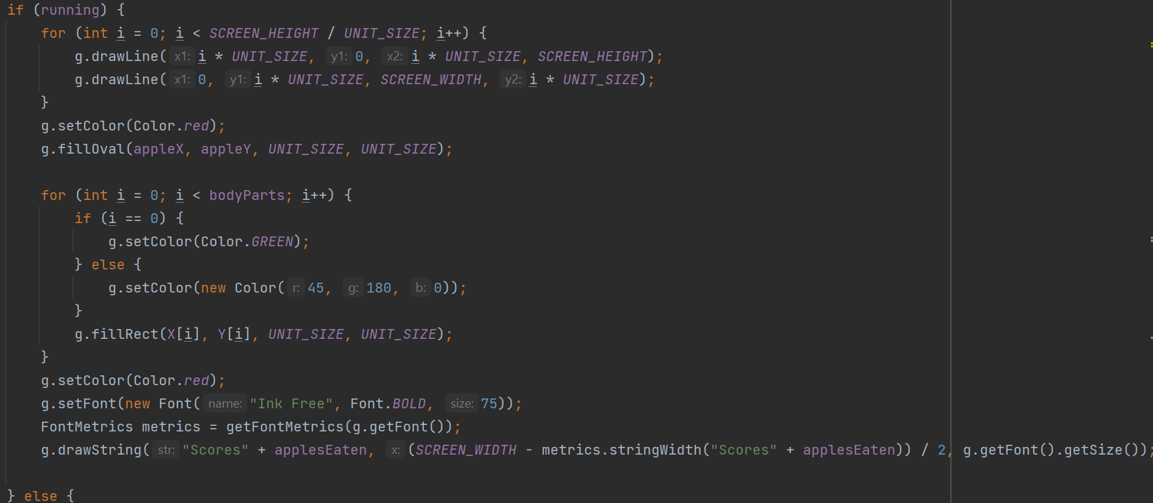
Design of snake, apples and lines

Slide 6
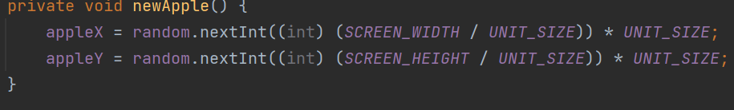
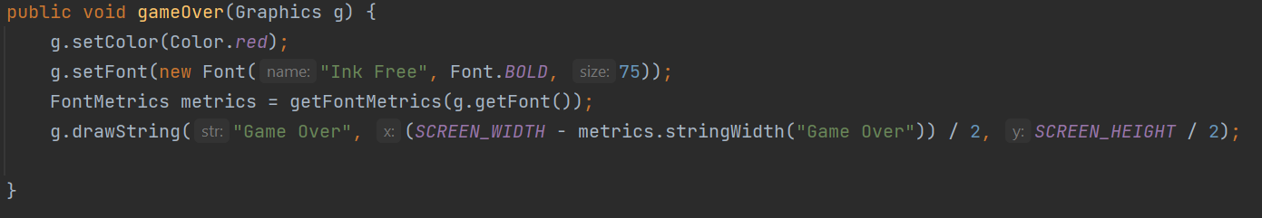
Apples
Game Over

